Slide 1
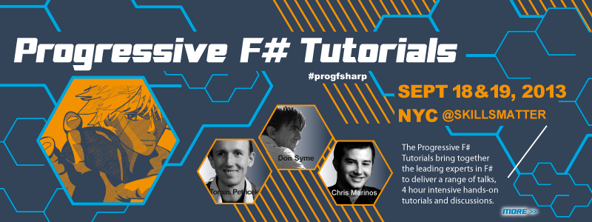
Welcome! Wendy Devolder, SkillsMatter

Slide 2
F# in the Open Source World
@dsyme,
Principal Researcher, Microsoft Research
F# Community Contributor

Slide 3
This talk has some slides provided by other people I’ll try to remember to tell you when that’s the case

Slide 4
Agenda
A tour through our broadening horizons
Ecosystems, Exosystems and The Digital World
Some initial thoughts on a new F# open initiative

Slide 5
Part I
F# is changing…
…in subtle but important ways
F# runs on many platforms
“F# is for Windows”

Slide 6
Overview
F# is changing…
…in subtle but important ways
“F# has many contributors”
“Microsoft
makes F#”

Slide 7
Overview
F# is changing…
…in subtle but important ways
“F# is
one language with many tools”
“F# is part of
Visual Studio”

Slide 8
Overview
F# is changing…
…in subtle but important ways
Many perspectives
http://fsharp.org
One perspective
(Microsoft’s)
http://msdn.microsoft.com

Slide 9
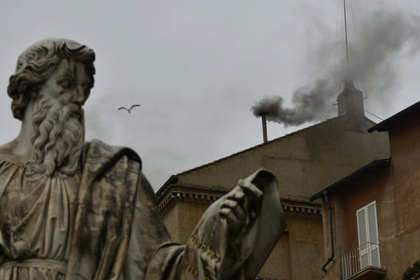
Old think…

Slide 10



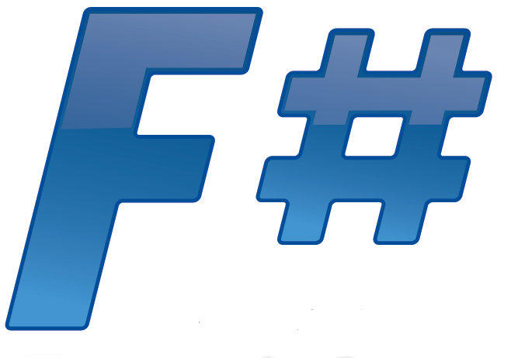



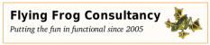

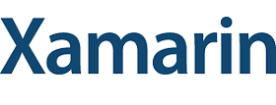



New think…
Visual Studio, .
.NET, SDKs, Tools
…
Visual F# Tools
F# Language
F# Open Source
Group
tryfsharp.org
F# Software
Foundation
F# Community
Groups
fpish.net
tryfs.org
fssnip.net
tryfs.org
fsharpforfunandprofit.com
Xamarin Studio

Slide 11
http://fsharp.org

Slide 12
Why do Microsoft contribute to F#?

Slide 13
functional-first = simple code to solve complex problems = improved time-to-market for code-heavy programming

Slide 14
better programmability = better platforms = make money

Slide 15
“functional-first” = “simple code” Let’s just remind ourselves about that…

Slide 16
Now let’s look more broadly…

Slide 17
Tour: Core Components

Slide 18
F# open source group fsharp.github.com e.g. F# Compiler “Open Edition”

Slide 19
fsharp.github.com/fsharp
F# 3.0
Apache 2.0 license
Mac, Linux, Windows, Browsers, Android, iOS
Compiler, Library, Build, F# Interactive, Compiler API
Run by the F# Open Source Group
fsharp.github.com/fsharp

Slide 20
Tour: Libraries and Packages

Slide 21
Ecosystem Exosystem

Slide 22
nuget.org

Slide 23
11,500 unique packages Windows, Mac, Linux

Slide 24
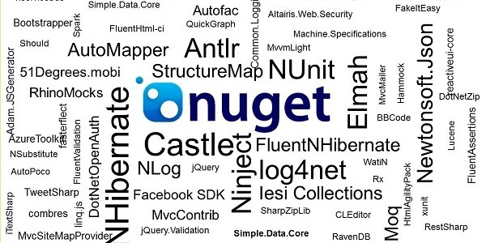
www.nuget.org

Slide 25
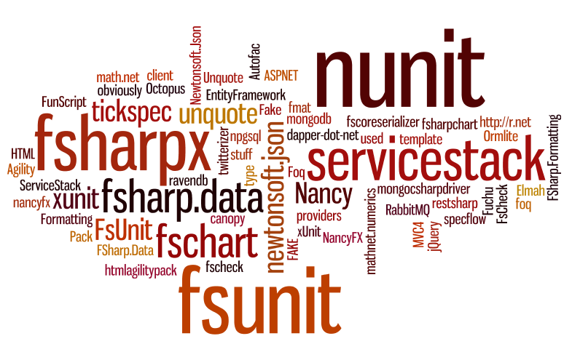

Slide 26
FSharp.Data FSharp.Charting FSharpx ExtLib

Slide 27
Latest news: Data Frames for F# BlueMountain Capital, contributing to F# open source work

Slide 28
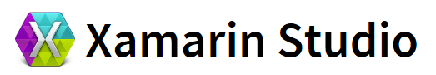


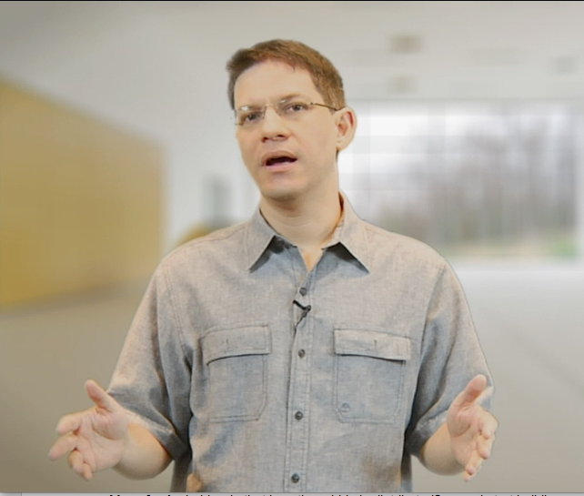




Tour: IDEs

Slide 29
F# in Emacs https://github.com/fsharp/fsharpbinding/

Slide 30
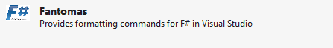
Fantomas https://github.com/dungpa/fantomas/ Ctrl-K Ctrl-F Code Formatting for F#

Slide 31
FSharpBinding F# AddIn for MonoDevelop and Xamarin Studio https://github.com/fsharp/fsharpbinding/

Slide 32
New: Tsunami Scripting Tools http://tsunami.io demo videos Can also be embedded, consulting available (contact them)

Slide 33
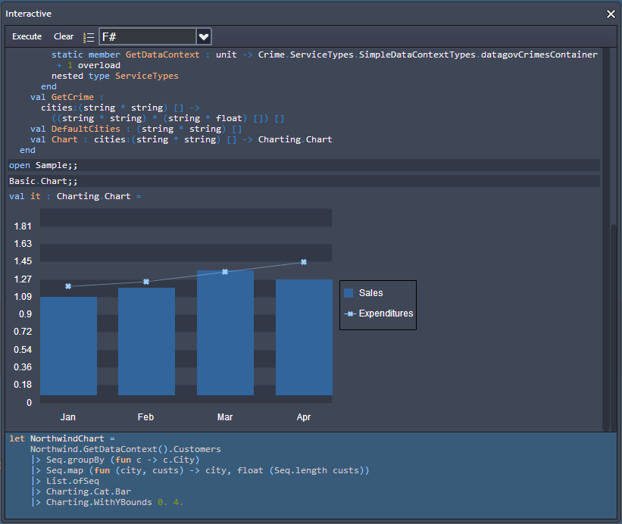
Upcoming:CloudSharper
http://cloudsharper.com
F# Development Environment in the Cloud
Full F# language support
Multi-project solutions
Web and mobile Apps
Syntax highlighting
On the fly type checking
Interactive exploration
Integration with data
Support for type providers

Slide 34
Tour: Web and Service Programming

Slide 35
Demo: F# + ASP.NET in Xamarin Studio

Slide 36
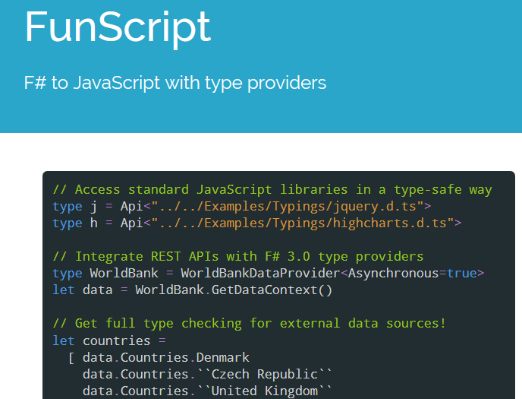
F# to JS via F# quotations
Community made, open-source
Open source license
TypeScript Type Provider for interop

Slide 37
Demo: FunScript

Slide 38
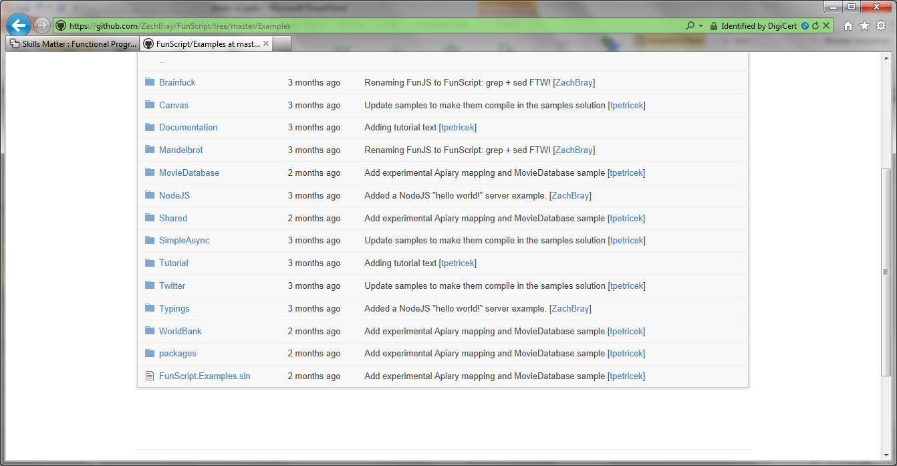

Slide 39
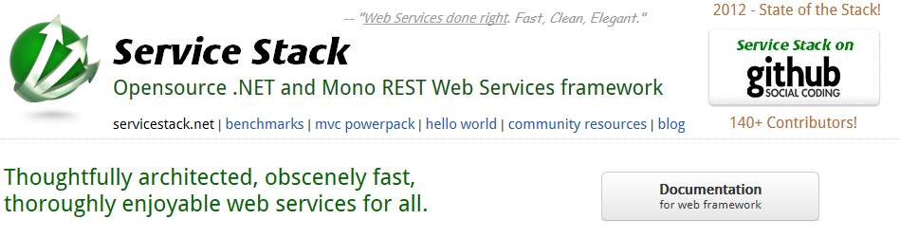
www.servicestack.net

Slide 40
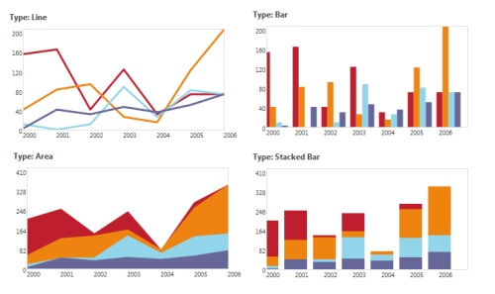
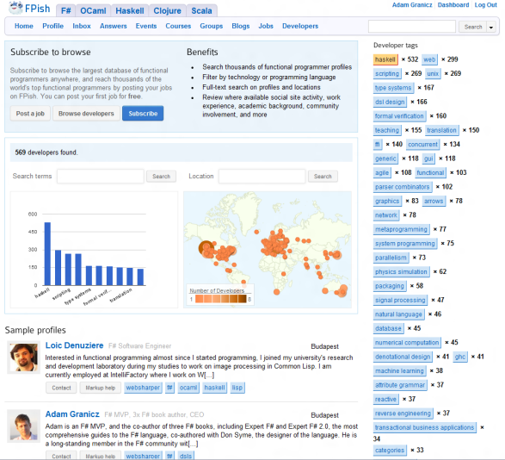


WebSharper
Web and Mobile Framework for F#
http://websharper.com
#websharper
Mature, enterprise-ready
Write all your server+client code in F#
Get a complete web or mobile application
Interface with any client-side JS library via F#
Powerful functional web abstractions
Automatic resource management
Safe URLs, type-safe URLs
and much-much more…
Develop applications with
Less code - 50-90% less
Quicker to develop – on average we find 2-3x
Easier to maintain – Significant $$ savings

Slide 41
Tour: Cloud Programming

Slide 42
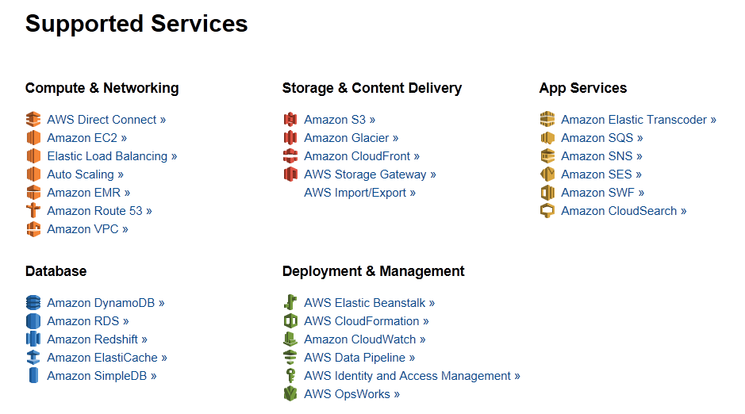
Amazon Web Services .NET SDKs http://aws.amazon.com/tools https://github.com/aws (Apache 2.0)

Slide 43
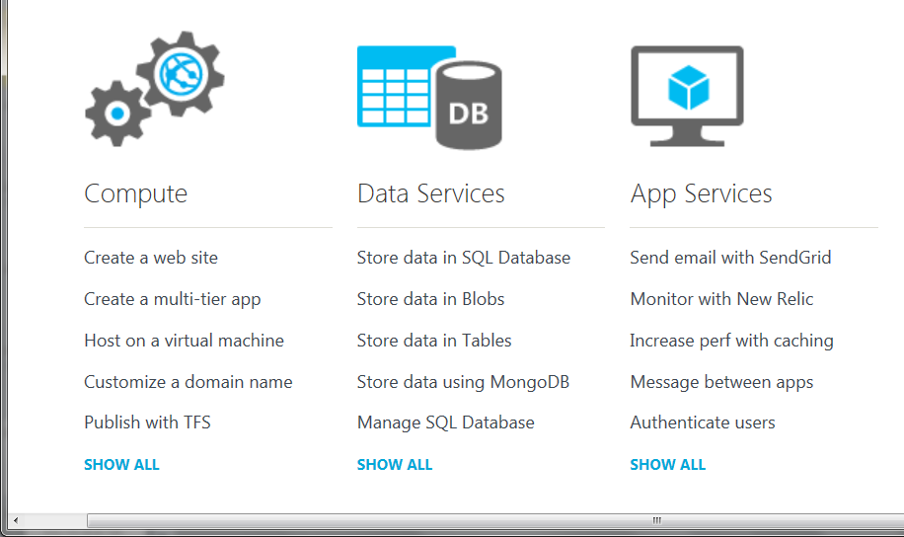
Azure .NET SDKs http://www.windowsazure.com https://github.com/WindowsAzure/ (Apache 2.0)

Slide 44
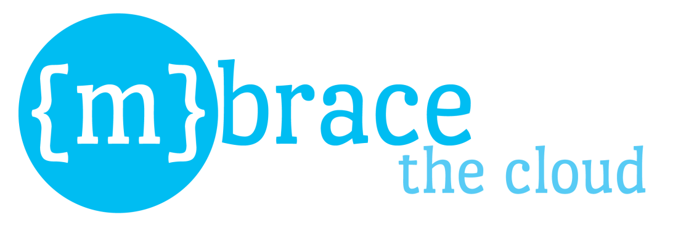
http://m-brace.net
A big data framework for private and public clouds

Slide 45
Tour: Building, Mocking, Testing, …
FAKE, Moq, Foq, Nunit, XUnit, TestSpec, FsUnit, …

Slide 46
Tour: GPGPU Programming
search on nuget for GPU or CUDA!
search on google for “C# GPGPU”

Slide 47
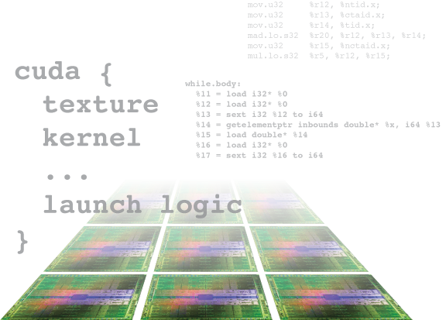
Alea.cuBase
Complete solution to develop CUDA accelerated GPU applications in .NET
Based on LLVM and CUDA 5 technology
Uses F# code quotation
Source code solution
No wrappers, no post build process to transform IL code
Our base technology for GPU projects
Dynamic code
generation
GPU algorithm
scripting
Industry grade
performance
Rapid
development
Solid framework
for reusability
Advanced CUDA programming

Slide 48
Tour: Math and Statistics Packages
See http://fsharp.org
Search on nuget for statistics
Math.NET, ExtremeOptimization, F# for Numerics, FCore, NMath, …

Slide 49
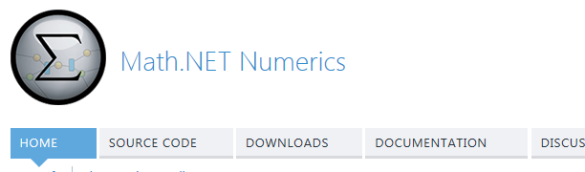
Math.NET Numerics A classic F# exosystem project Some latest news

Slide 50
Part I: Summary
F# is open source, cross-platform with many contributors
The core compiler and library are done at Microsoft using a “code drop” model
The fsharp.org community are OK with that
The F# Exosystem is big, rich, active and multi-faceted

Slide 51
Part II From Broad, to Really, Really Broad

Slide 52
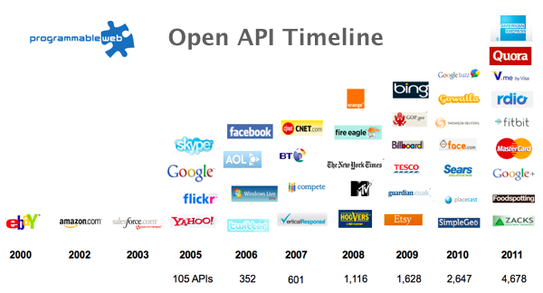
Recap: The Information Revolution

Slide 53
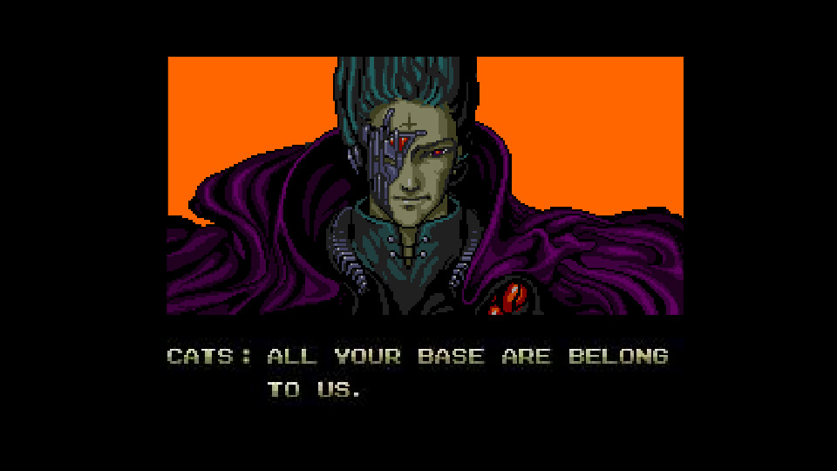
All your types are belong to us….
types

Slide 54
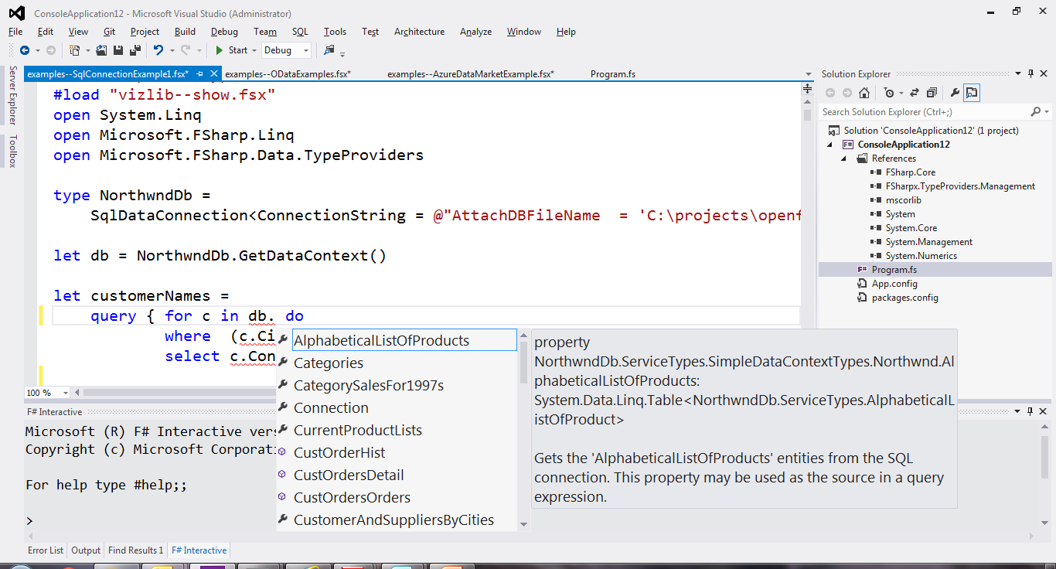
SQL

Slide 55
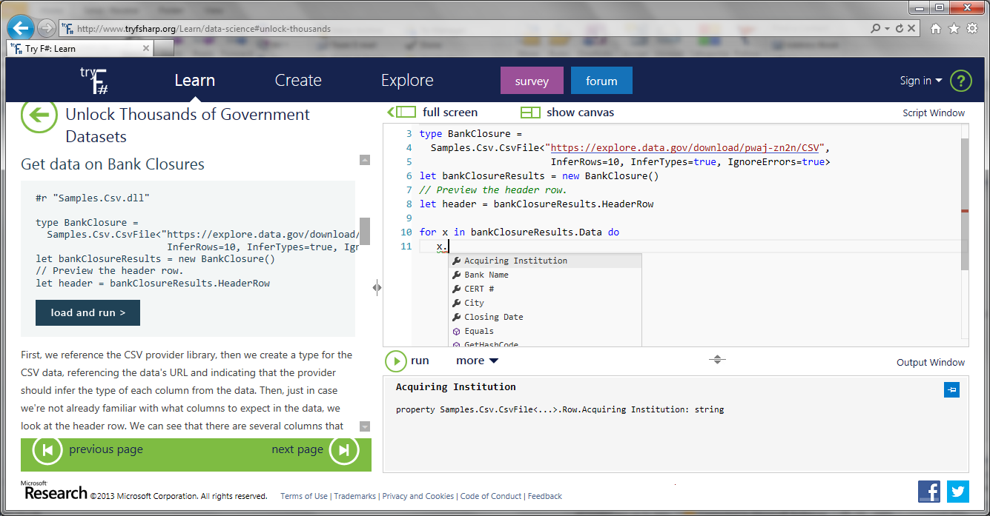
CSV

Slide 56
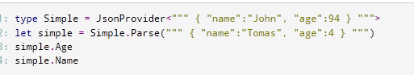
JSON

Slide 57
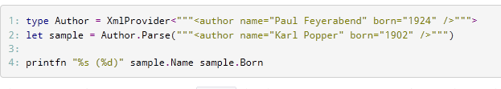
XML

Slide 58
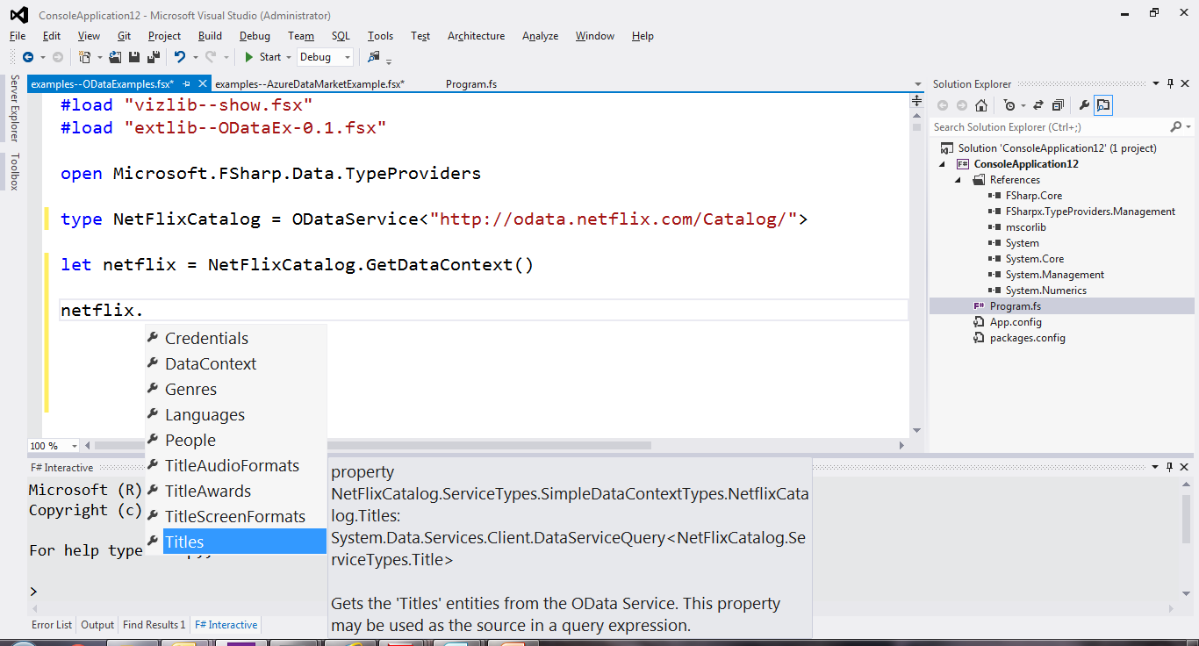
OData

Slide 59
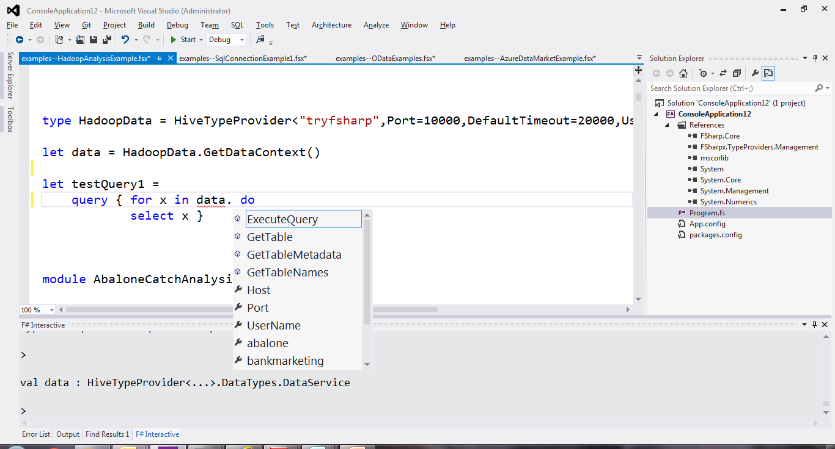
Hadoop/Hive

Slide 60
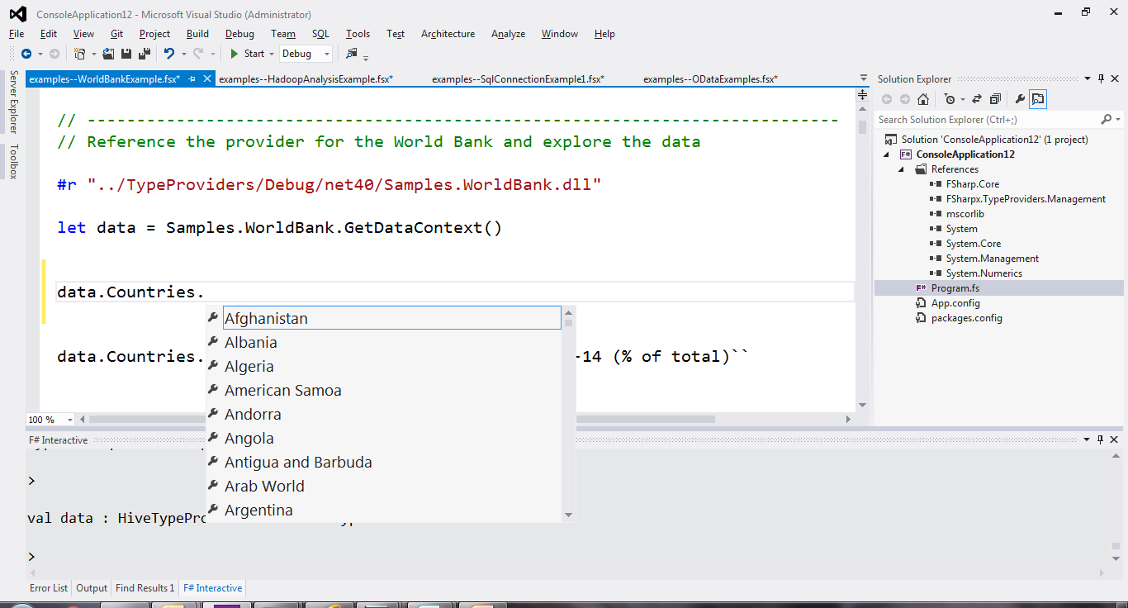
World Bank

Slide 61
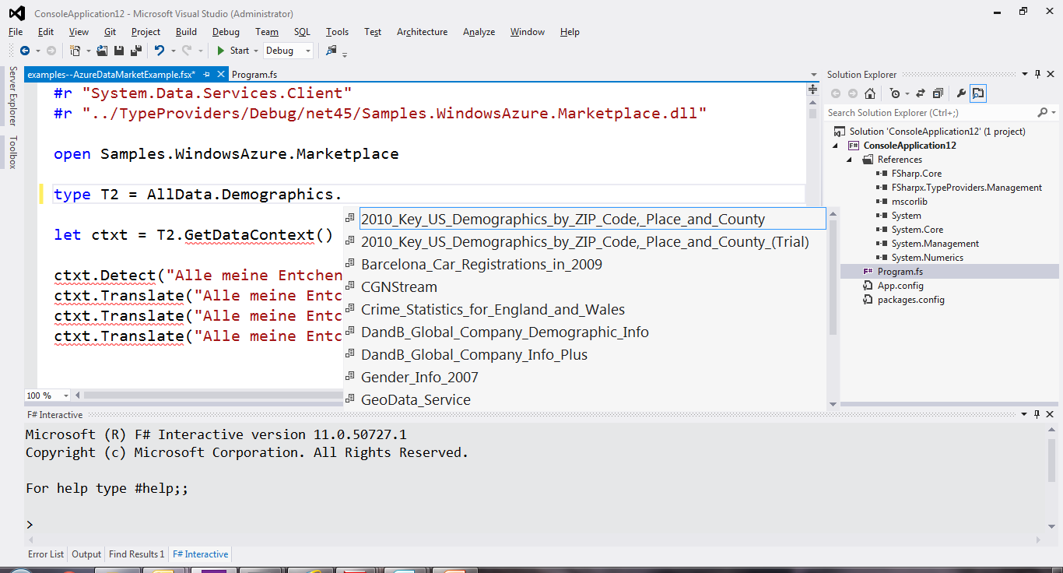
Azure Data Market

Slide 62
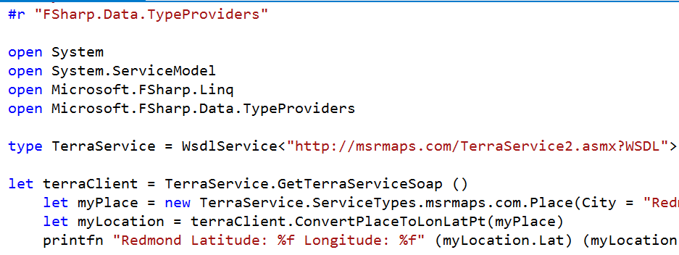
WSDL

Slide 63
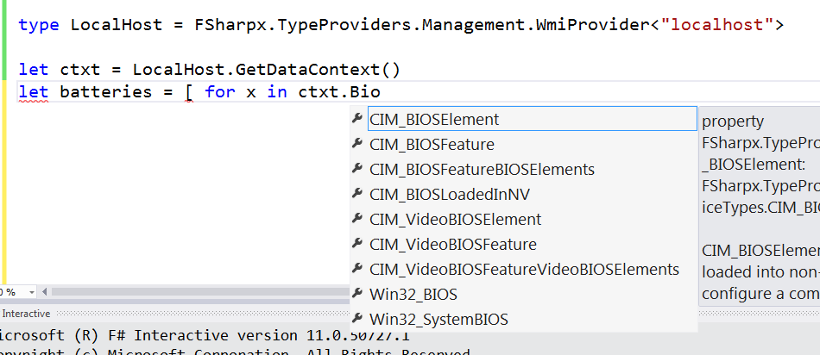
WMI

Slide 64
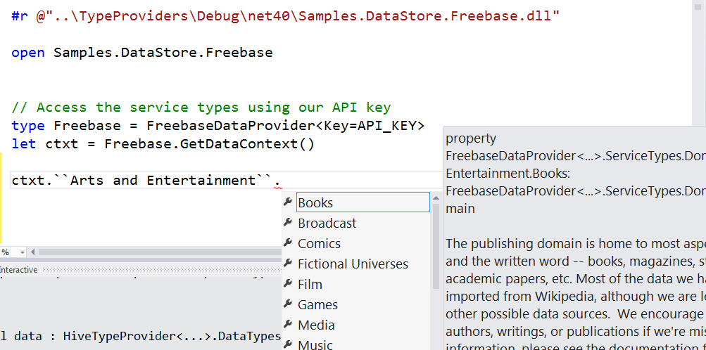
Freebase

Slide 65
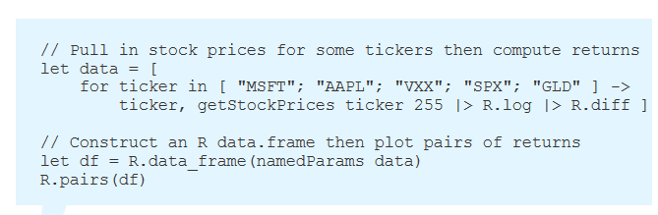
R

Slide 66
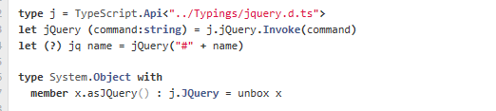
TypeScript

Slide 67
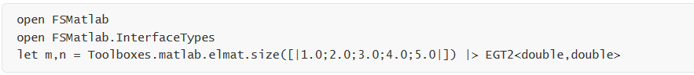
Matlab

Slide 68
Update: RProvider
r provider f#
BlueMountain Capital
Open source, commercially sponsored community provider for interop with R
discovers installed R packages
Access > 2,000 R packages
projects them as .NET namespaces
underneath the parent namespace RProvider

Slide 69
Demo: F# to R

Slide 70
Part III Concluding Thoughts

Slide 71
Current Situation
.NET + F# Compiler + Library
Library
Library
Library
Library
Library
Library

Slide 72
Future Situation?
“FBase”
.NET + F# Compiler + Library
Library
Open
Library
Open
Library
Open
Library
Library

Slide 73
Future Situation?
Characteristics?
“Open Source and Free”
“Multi Platform “
“Approved by FSF Working Group(s)”
“Just a Combination”
“Elements Designed for Coherence”
“One Combined Nuget Package”
“Stable/Beta/Alpha Channels”
“Clear License(s)”
“No Silly Duplication of .NET/Mono”
“FBase”
.NET + F# Compiler + Library
Library
Math.NET Numerics
FSharp.
Data
FSharp.
Charting
Library
ExtLib v2
Rx
…

Slide 74
To discuss: Is this the right way forward? If so, could you be involved? How would we make this happen? What other design principles? Can you contribute to components today?

Slide 75
Summary
F# is about about leveraging and integrating external functionality
Through the wonderful lens of FP
Next Directions?
F# as a Language: FF + interop
Now a broader, community-led vision
Originally .NET+Visual Studio
F# broadly: many, many things going on!
F# at Microsoft: tooling, platforms, data

Slide 76
fsharp.org Questions?

